Slide 1

Aeromodelling Club
IIT Kanpur
Semester Project 2021
CAD FUSION 360
Project Mentors
1. Mohit Anand 2. Raj Agarwal 3. Pranshu Singhal

Slide 2
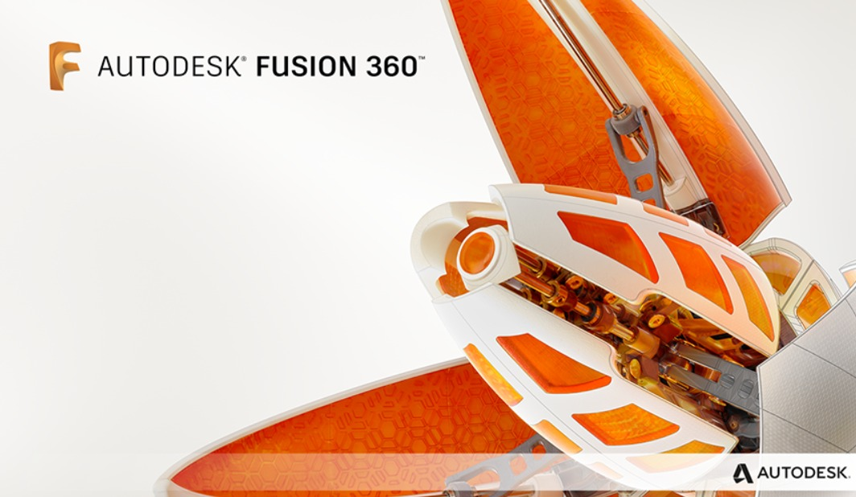
Content
Workspaces
Design
Assembly
Drawing
Animation
Simulation
Generative Design
Airfoil DAT to spline
Assignments
Designathon

Slide 3
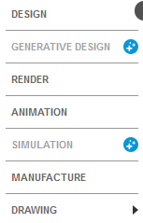
Workspaces
Main Focus :-
Design
Animation
Simulation
Drawing
Generative design

Slide 4
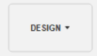
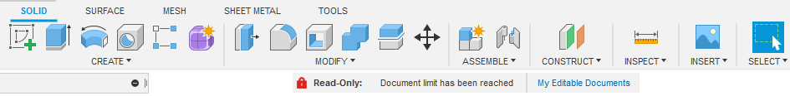
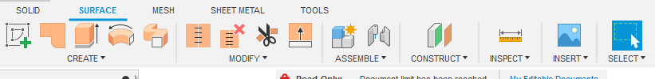
Design
Workspace
Solid Modelling
Surface Modelling

Slide 5
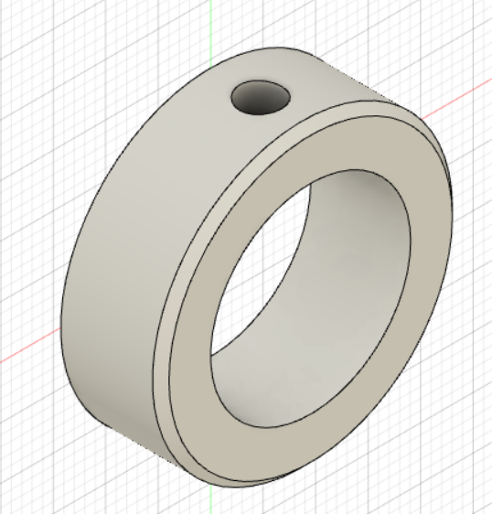
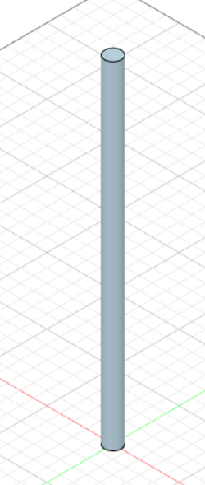
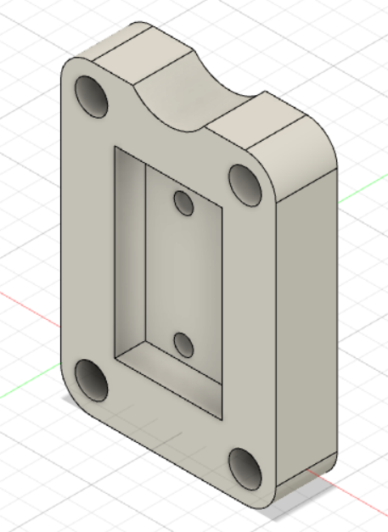
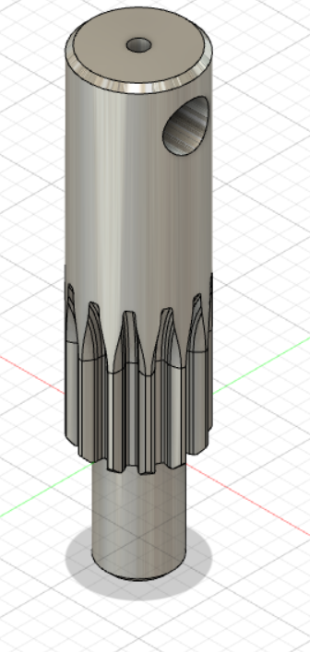
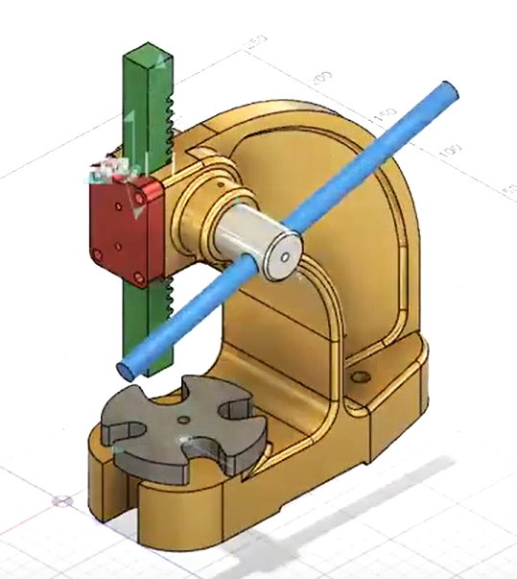
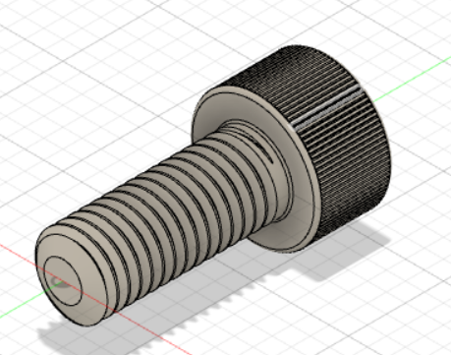
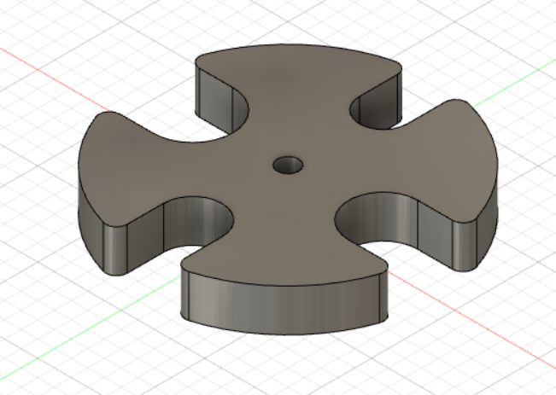
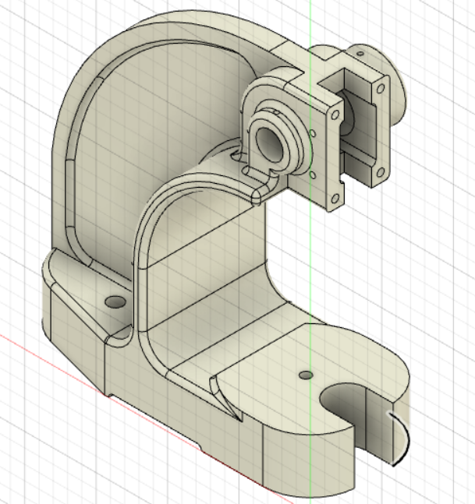
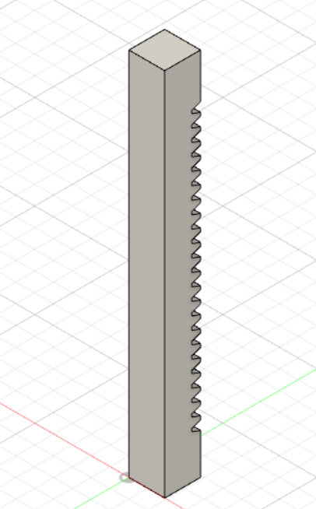
Assembly
An Assembly is a collection of different parts that function as a single design in Fusion 360.
Each design can contain:
A single component comprised of bodies.
An assembly of components and nested subcomponents.
When you create a new component in a Fusion 360 design, it becomes an assembly.
You can define relationships between components in a design using the position, joint, and motion features.

Slide 6
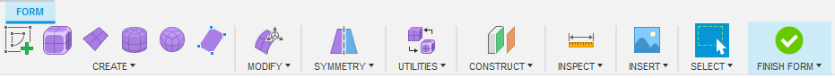
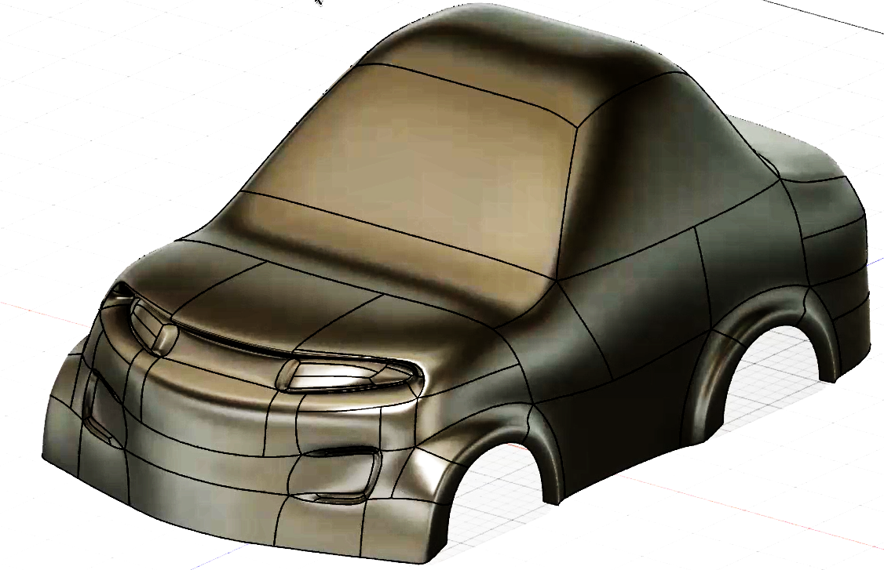
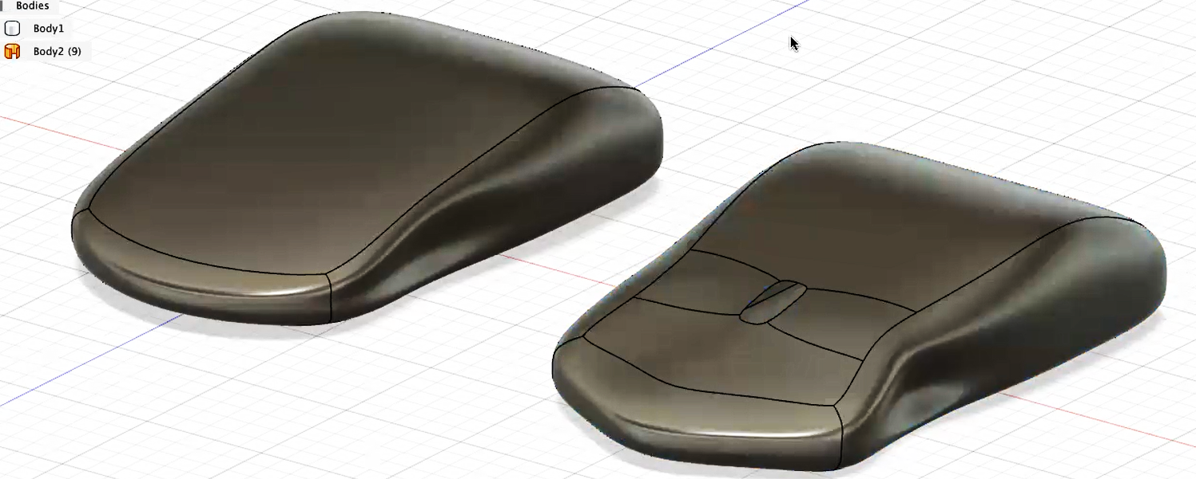
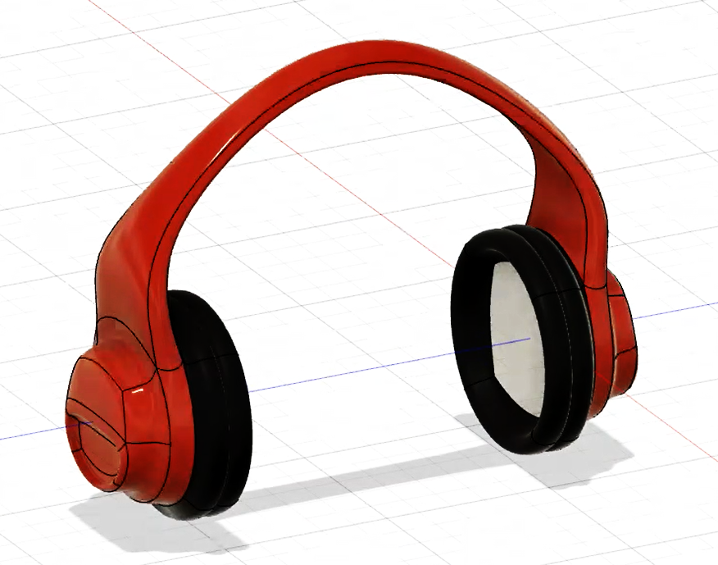
FreeForm
Modelling

Slide 7
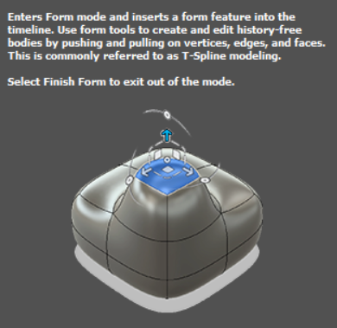
FreeForm Modelling
In the Form contextual environment in Fusion 360, you can create organic T-Spline designs with tools that are similar to sculpting clay.
You can push and pull faces, edges, and vertices on T-Spline bodies.
This environment lets you take a more fluid, artistic approach in the early conceptual stages of a design compared to the more traditional parametric design tools in the Solid and Surface tabs.

Slide 8
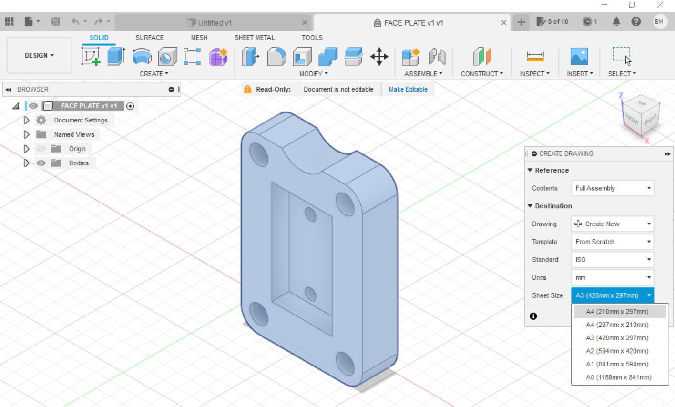
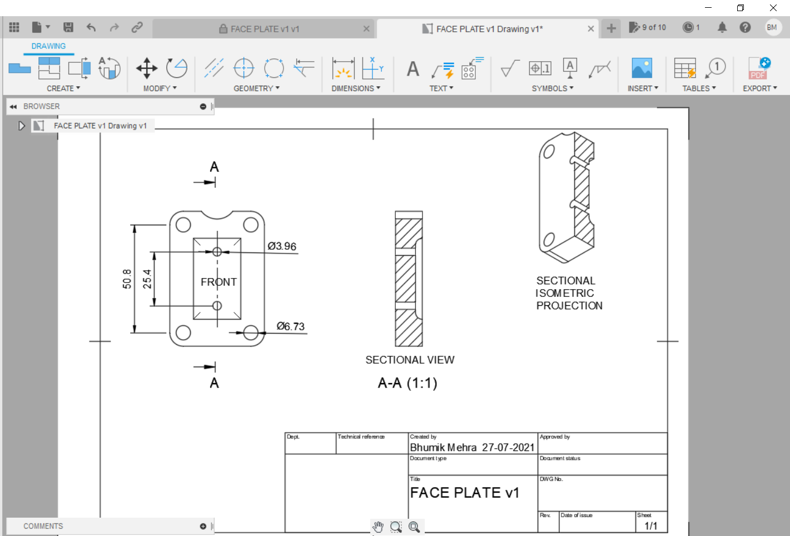
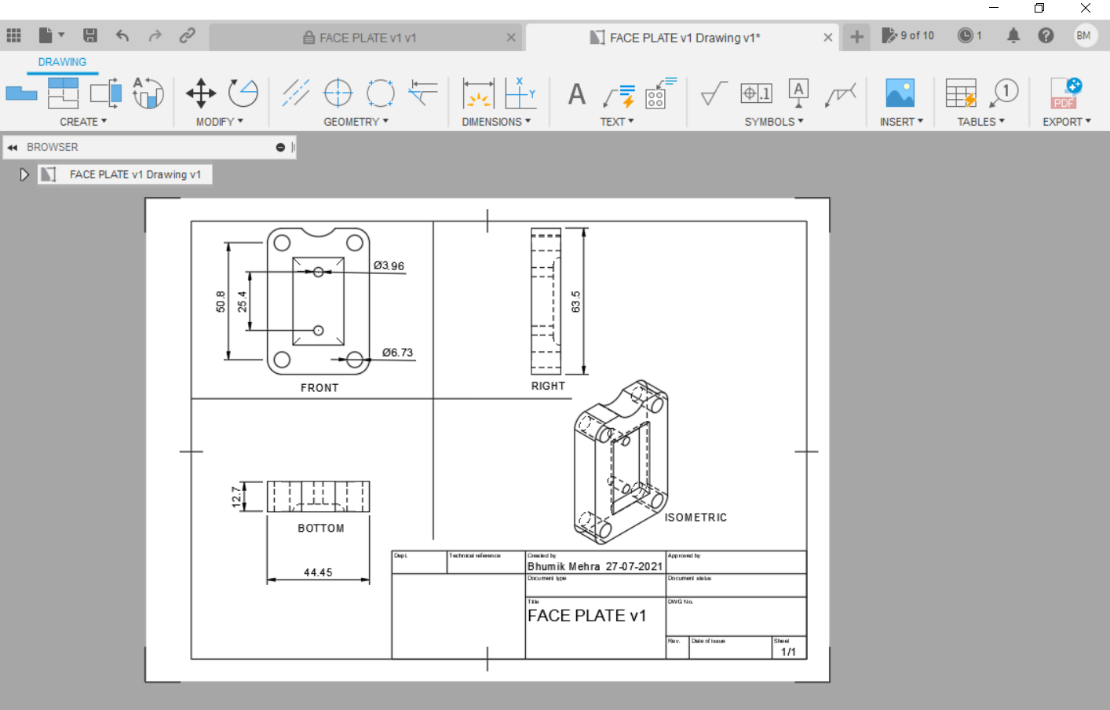
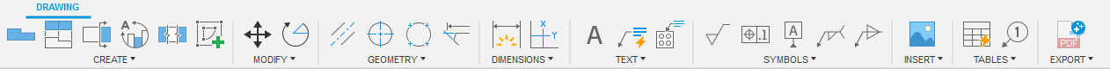
Drawing Workspace

Slide 9
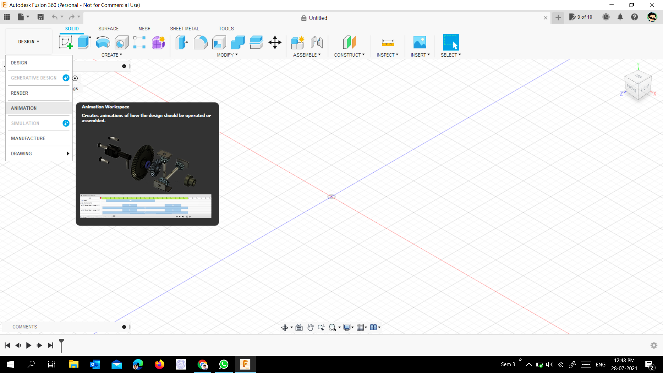
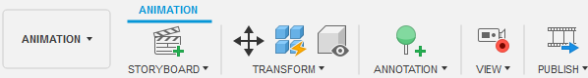
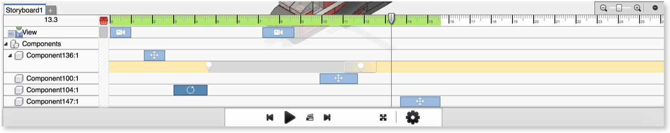
Animation
Workspace
Use the Animation workspace to create exploded views and to animate parts and assemblies. The use of Animation is to evaluate and communicate design functionality and illustrate assembly.

Slide 10
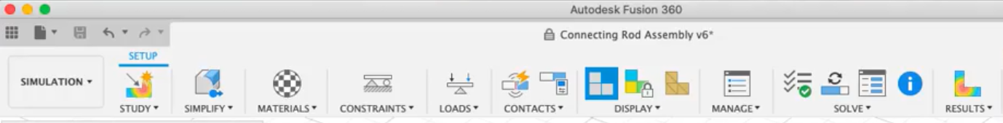
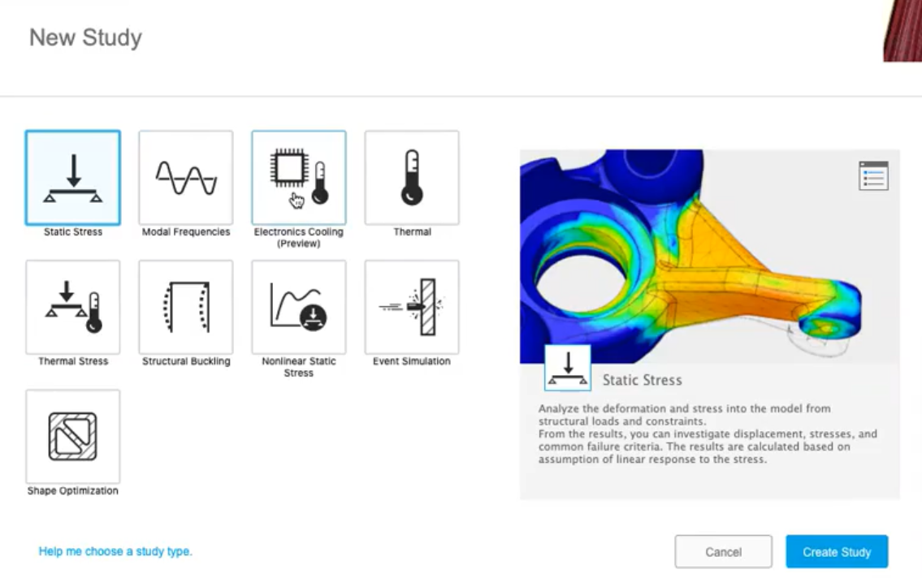
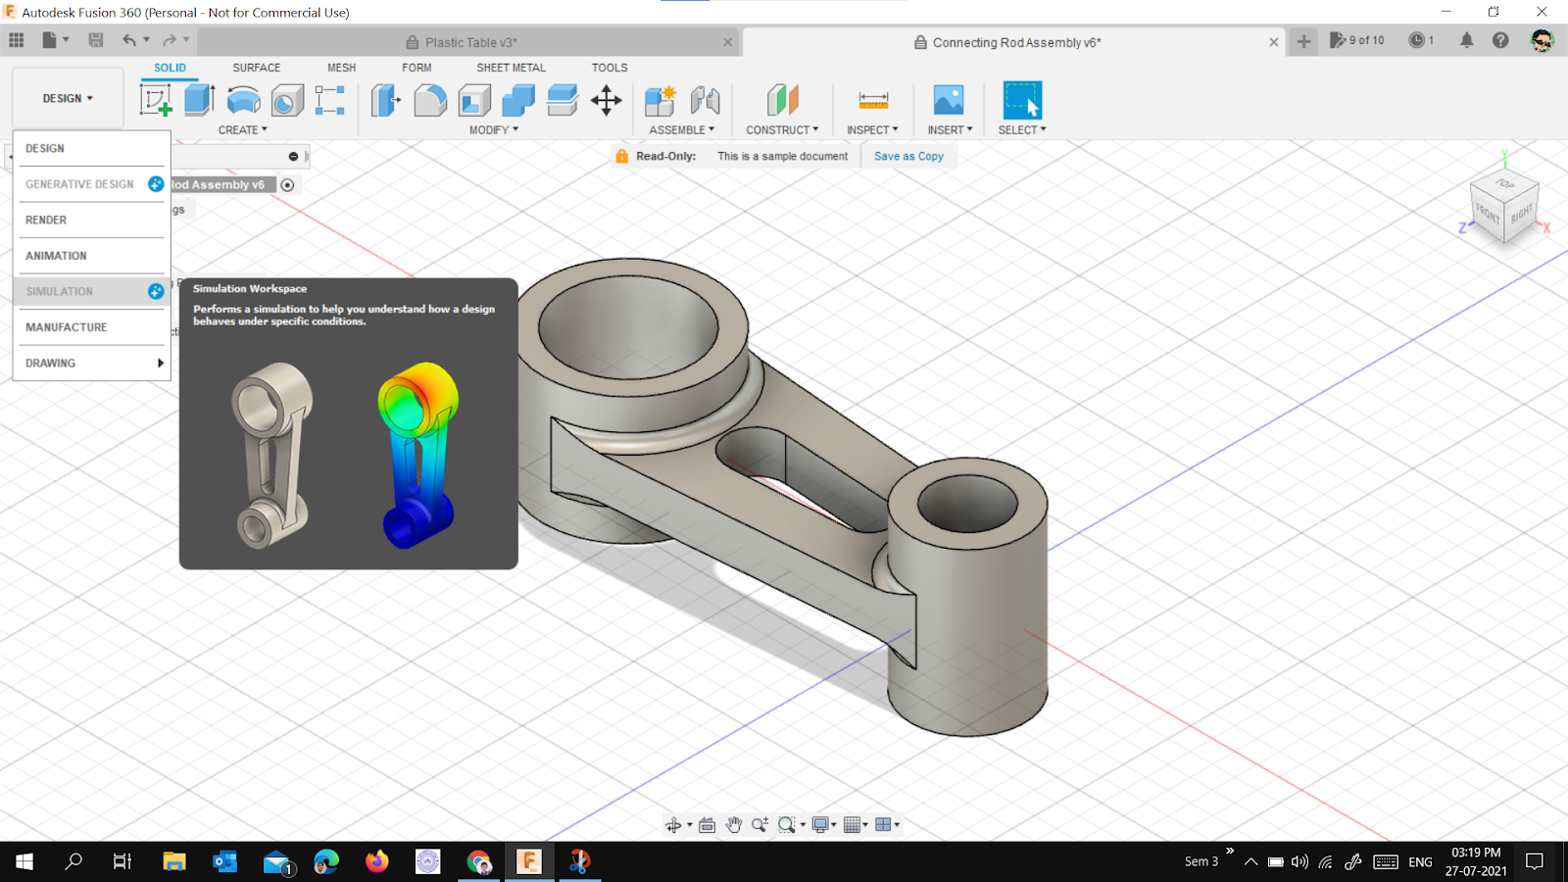
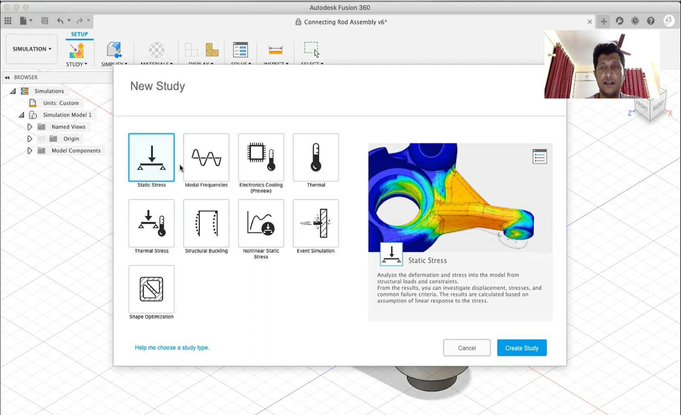
Simulation
Workspace

Slide 11
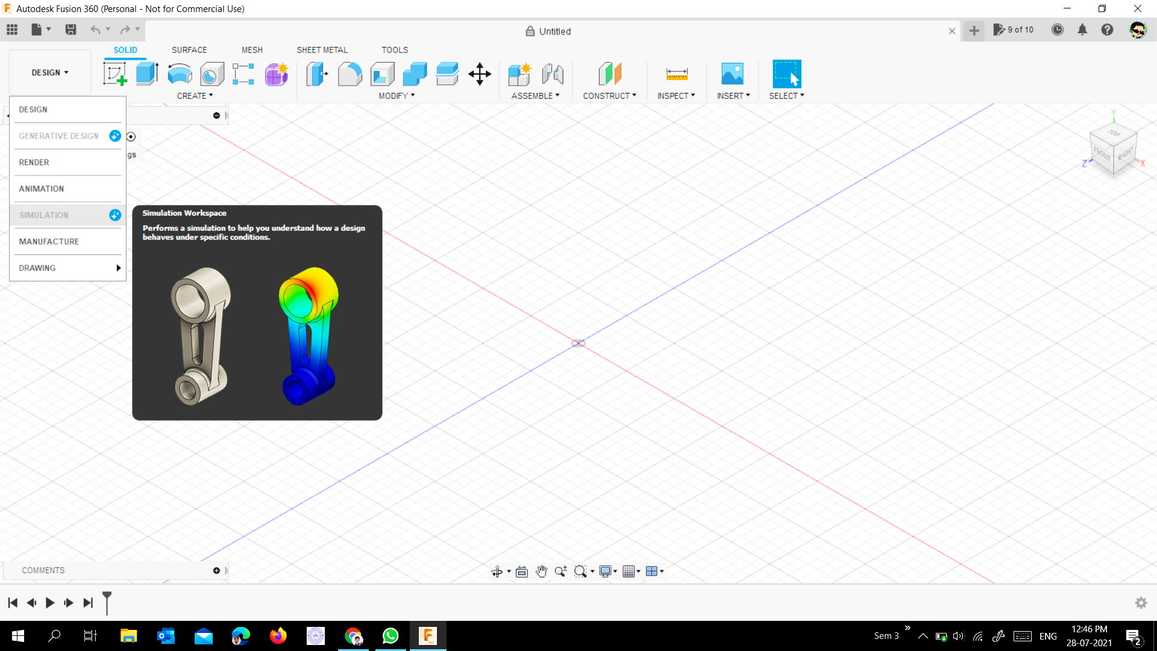
Simulation
Workspace
Simulation is essential for designers to justify their design with a given set of criteria.
Fusion 360 is in-built with simulation.
The simulation uses finite element analyses to predict performance.

Slide 12
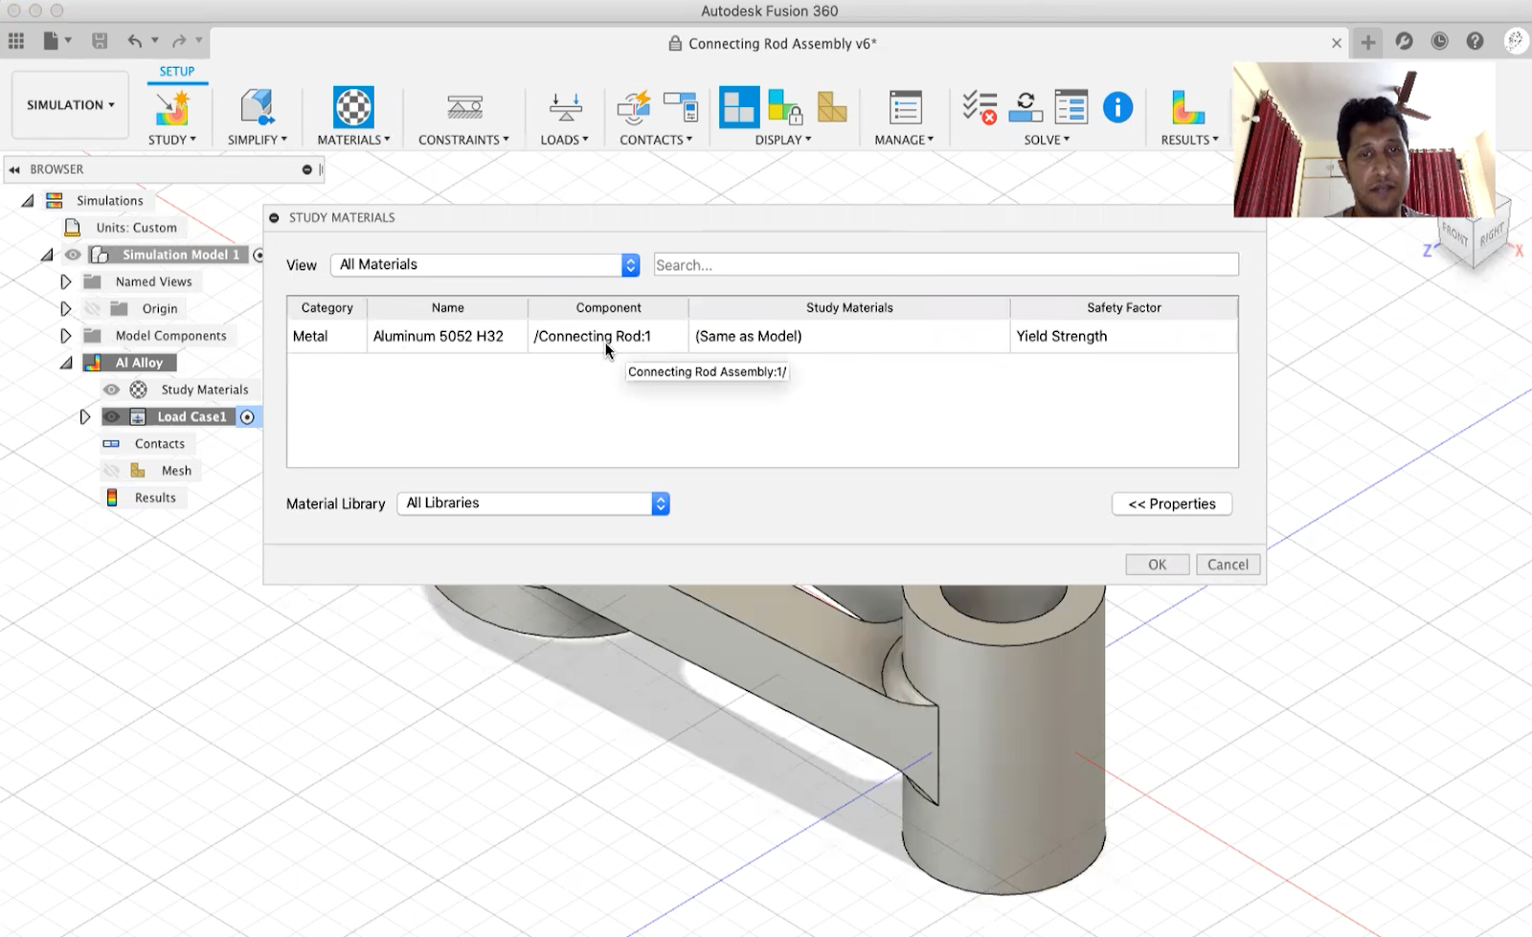
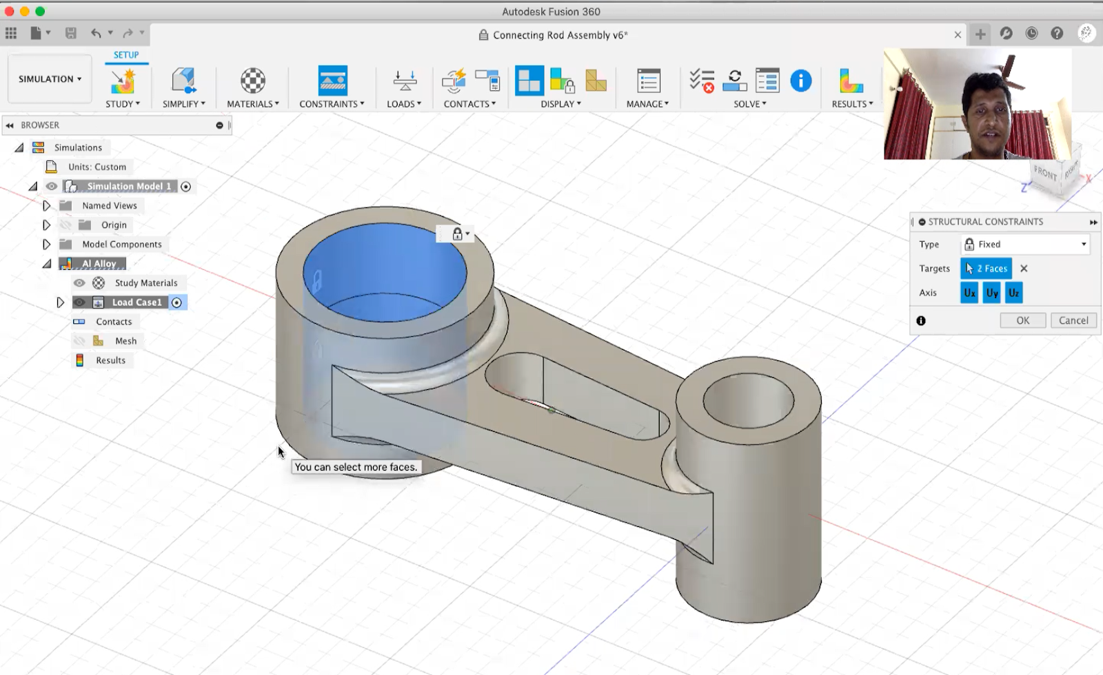
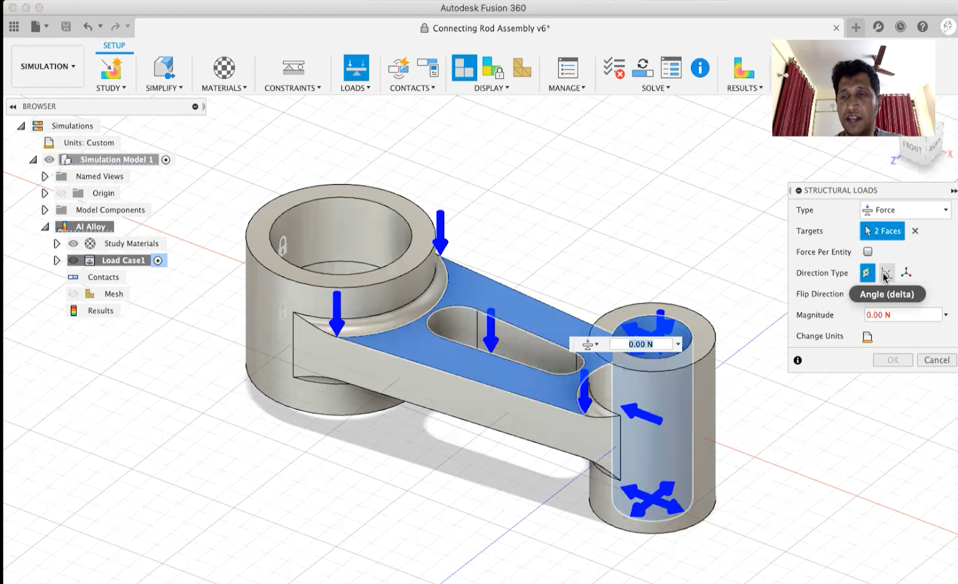
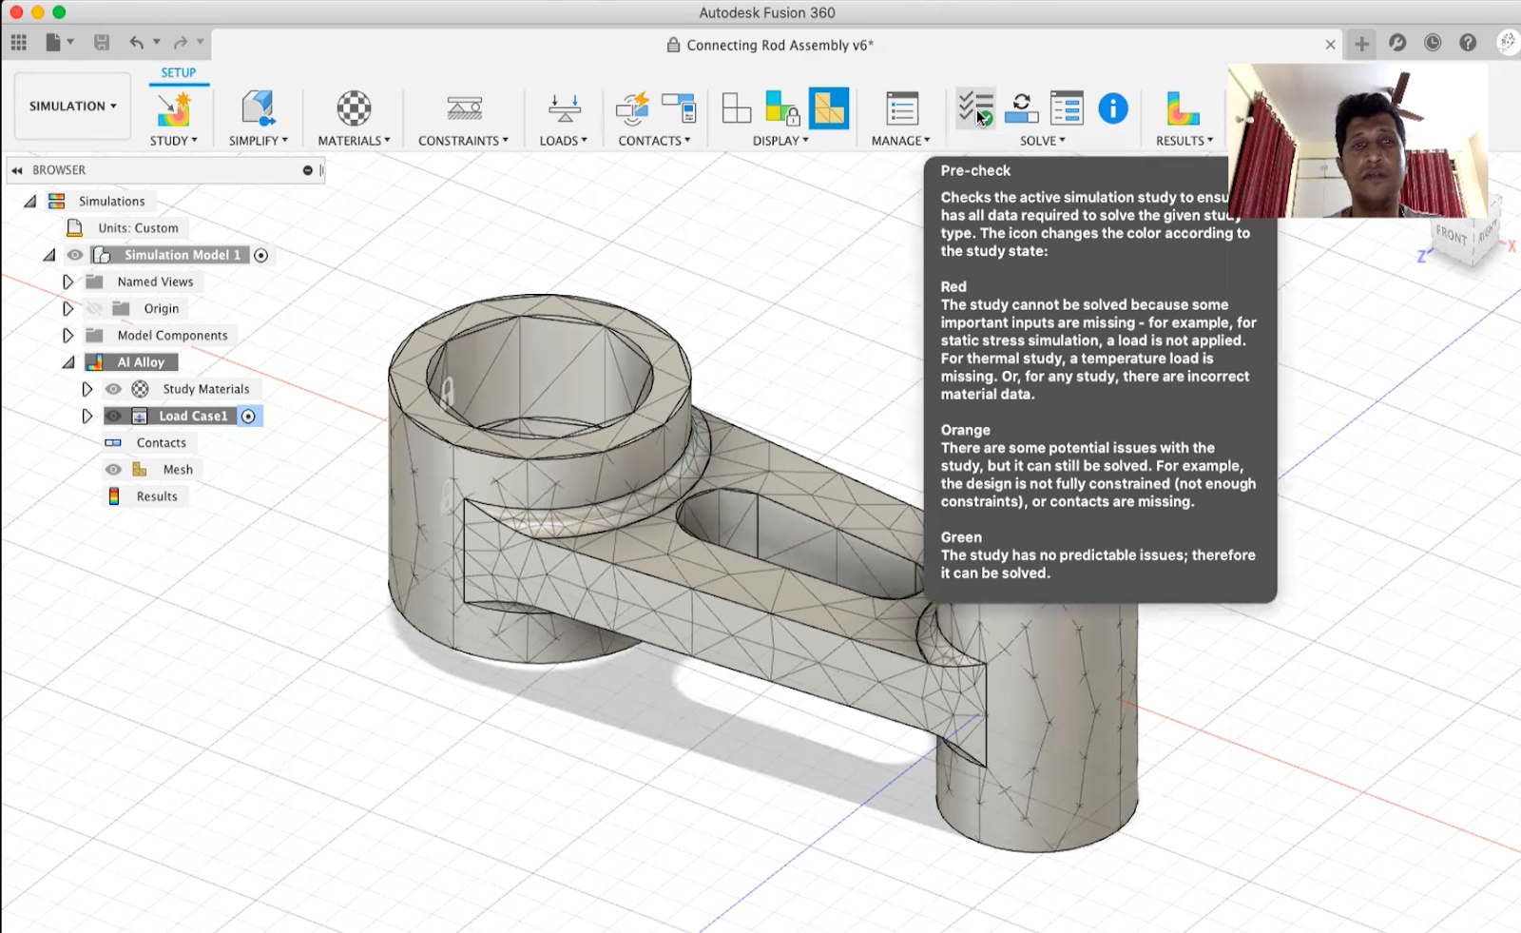
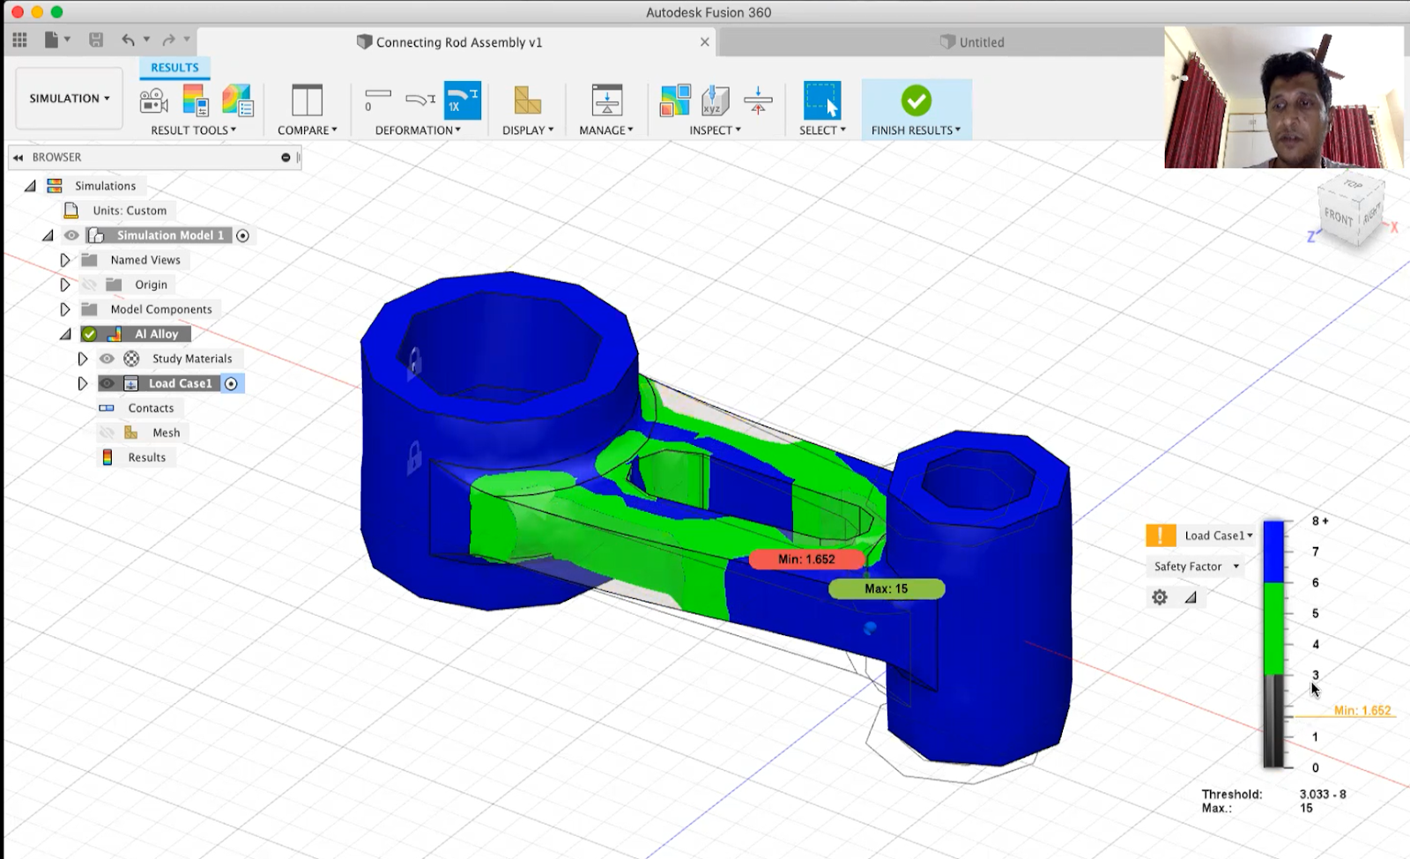
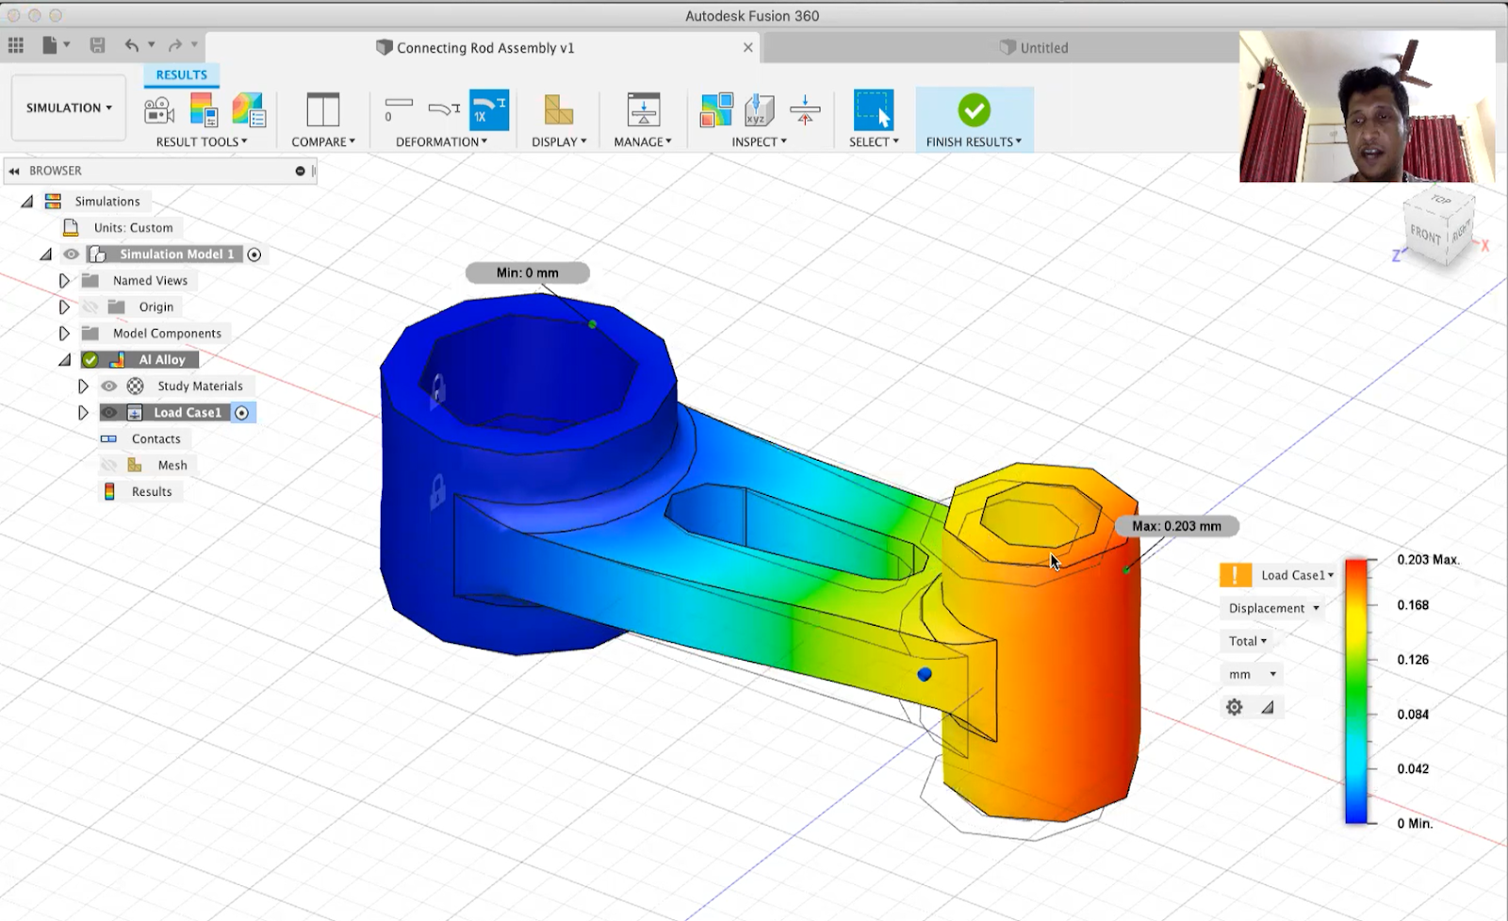
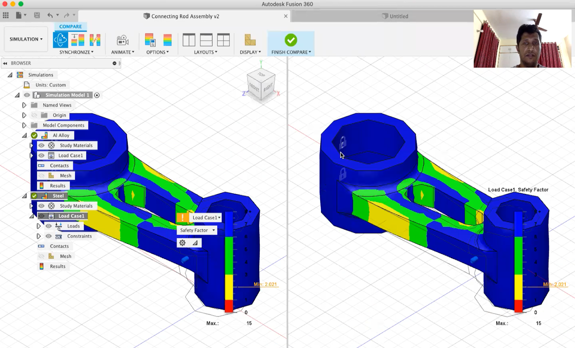

Slide 13
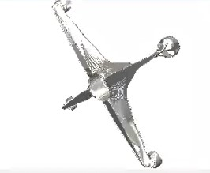
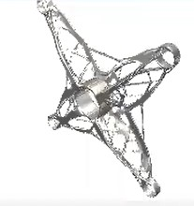
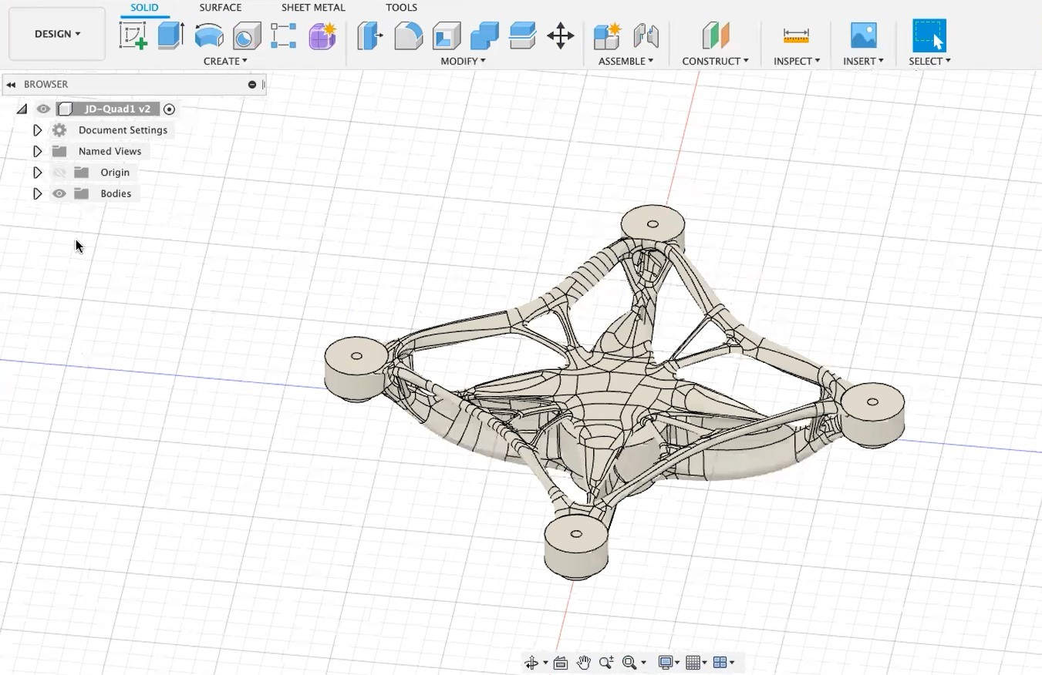
Generative design
Workspace

Slide 14
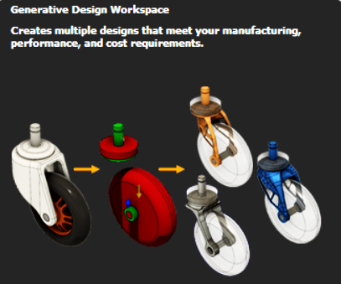
Generative Design
Workspace
Generative Design lets you define a design problem through goals and constraints and yields a collection of designs that meet your requirements. Then you can inspect the designs to select the one you desire the most and is optimal for your work.

Slide 15
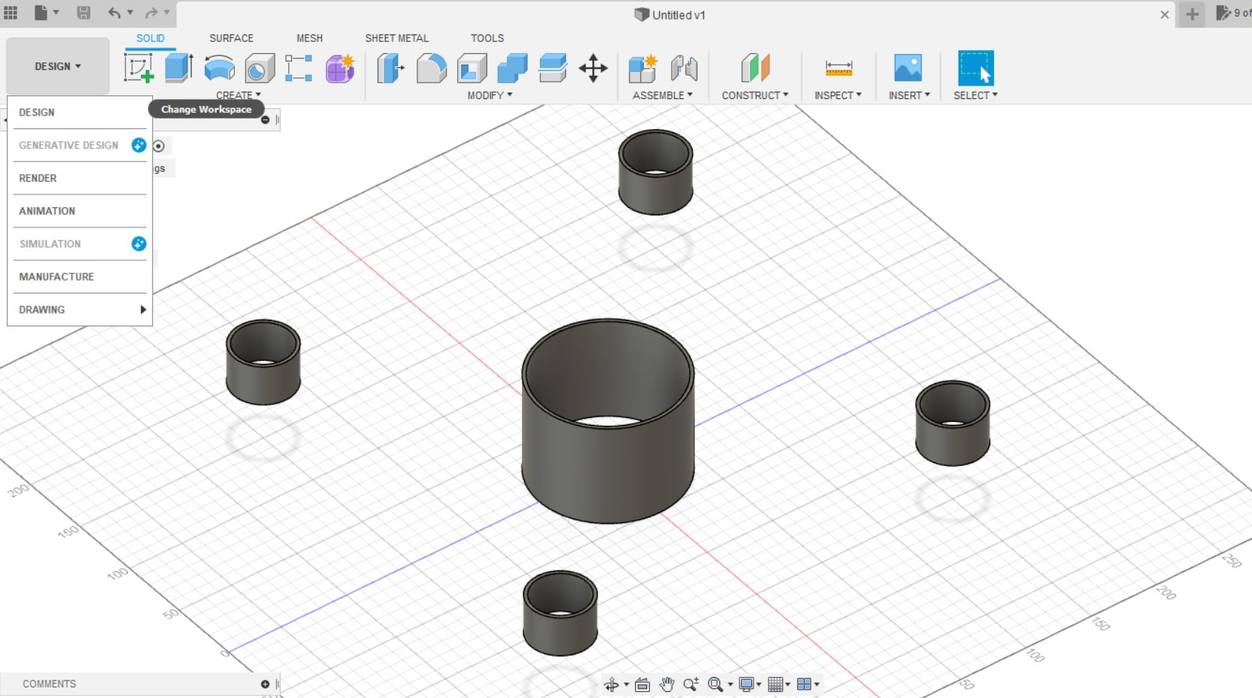
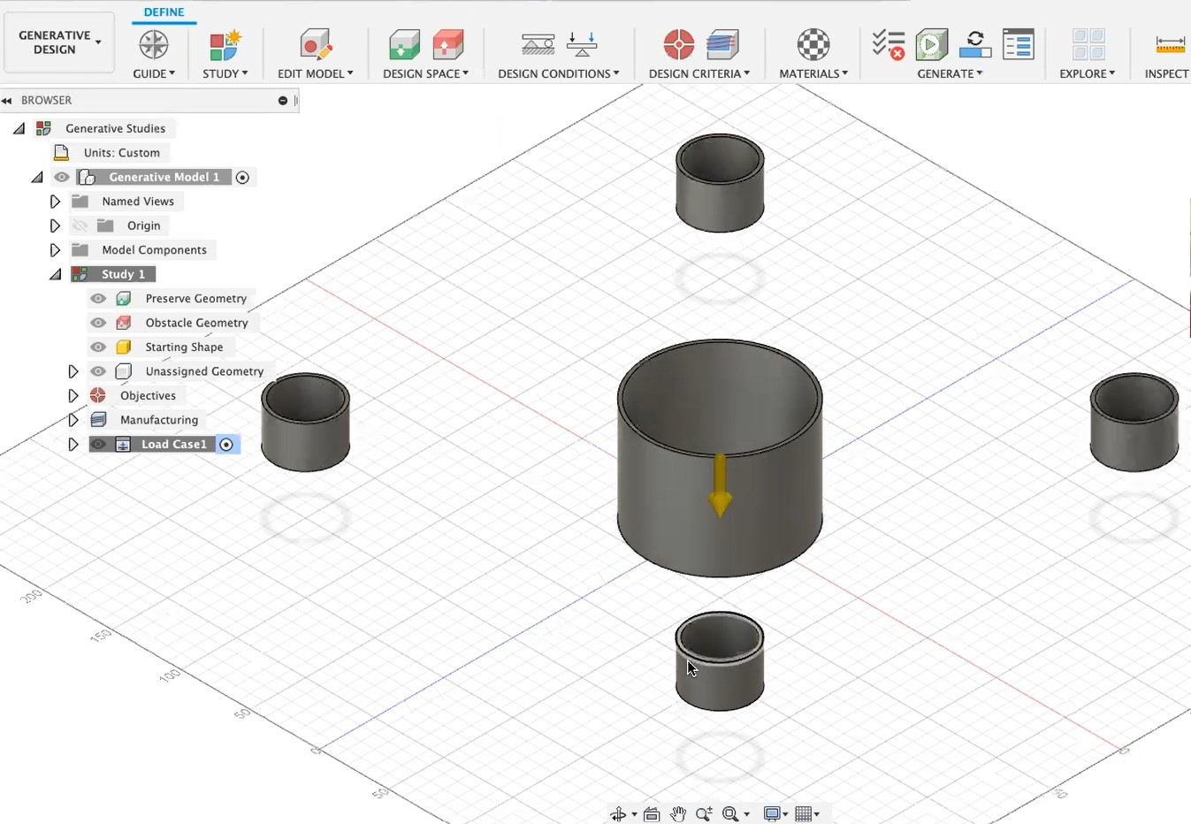
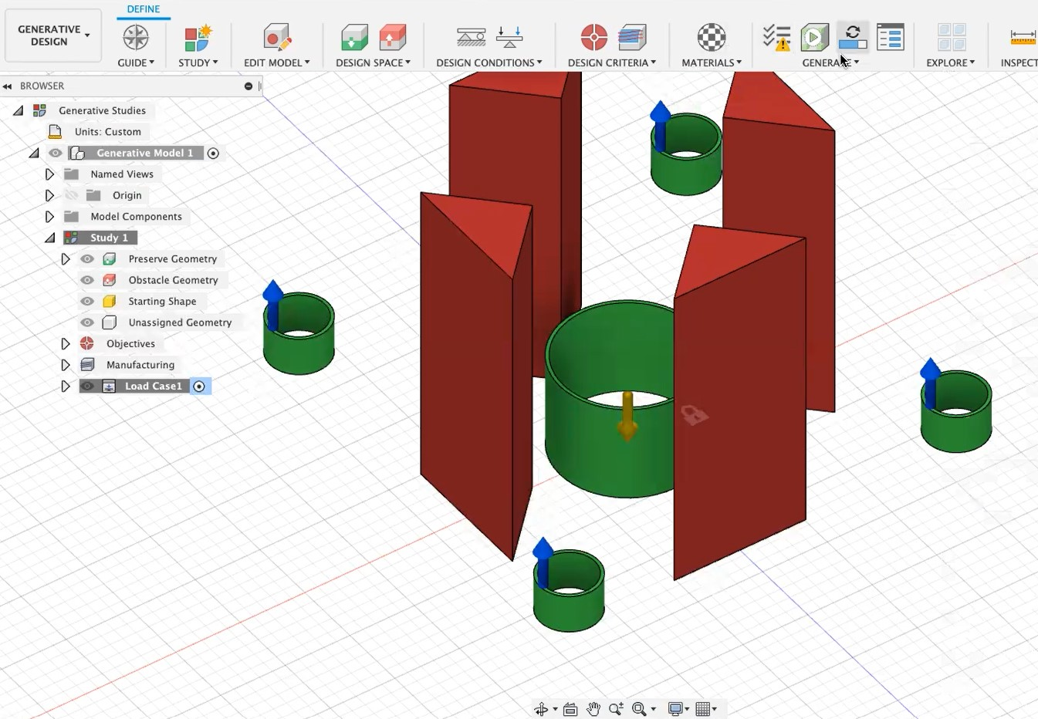
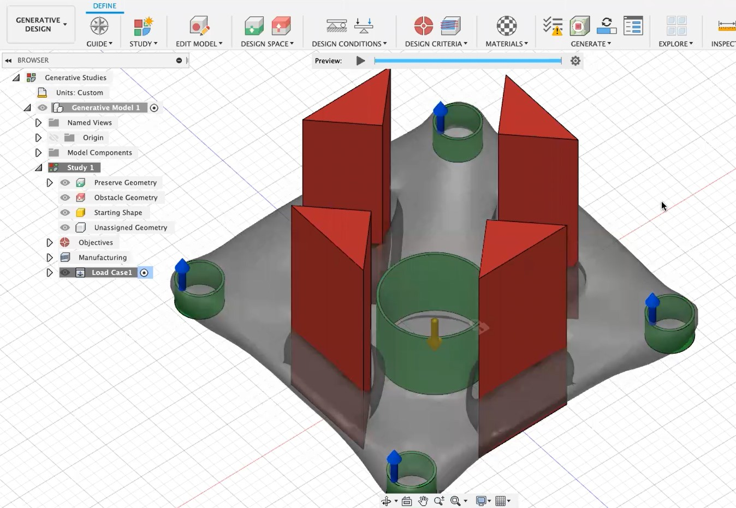
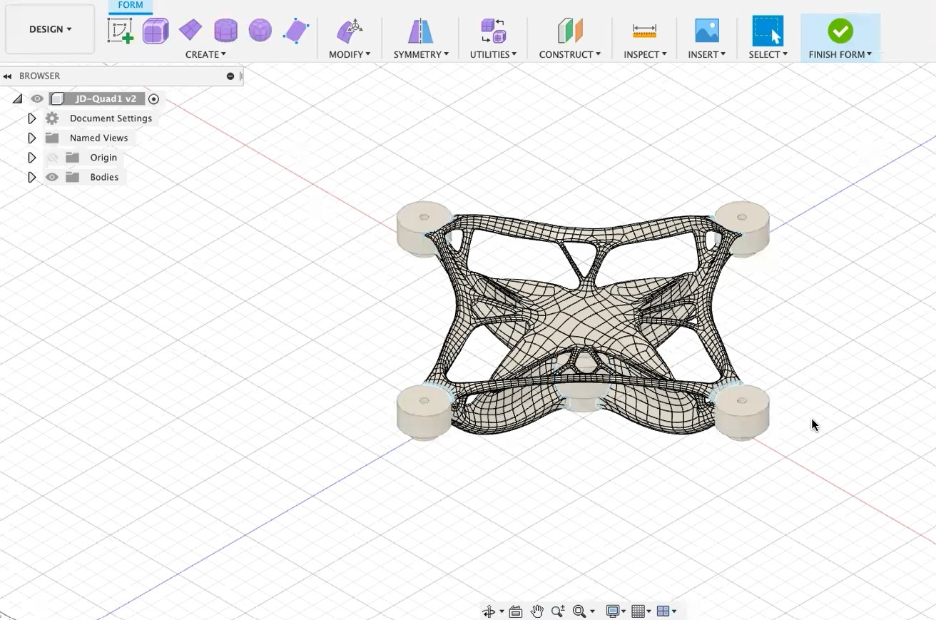

Slide 16
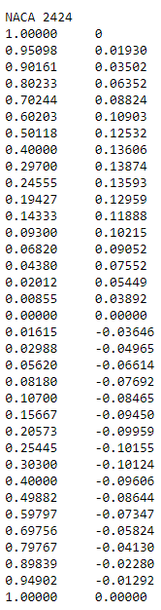
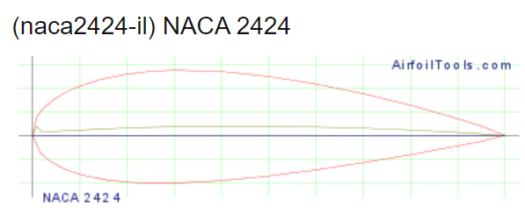
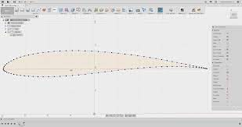
Airfoil DAT to spline

Slide 17


ASSIGNMENT
1

Slide 18


ASSIGNMENT
2

Slide 19


ASSIGNMENT
3

Slide 20

Remote controller

Slide 21

Aircraft

Slide 22








Designathon
https://a360.co/3iXK6Vf
https://a360.co/3y9sah3
https://a360.co/3x4oN9G
https://a360.co/3l5Nbpg
https://a360.co/3zY5rVN
https://a360.co/3zJfJsr
https://a360.co/3A6sE96
https://a360.co/3rE2mXK

Slide 23



CAD Designing Team
Aastha Sitpal
Bhumik Mehra
Preeti Kumari
Abhiyanshu Kumar
Keyur Panchal
Priya Satwika
Ajeet Kumar
Kritika Bansal
Rahbar Shakeer
Aman Kumar SIngh
Naveen Teja
Rohit Chaudhary
Anshika Singh
Padma Ram Rahar
Shivangi
Anukriti Singh
Paramveer Choudhary
Shubham Kumar
Aryan Raj
Prachi S Rahangdale
Sushma
Ashish Sharma
Prakhar Gupta
Vasu Paliwal
Baishali Das
Pratyush Gupta

Slide 24
THANK YOU
CAD Designing

